Slide 1
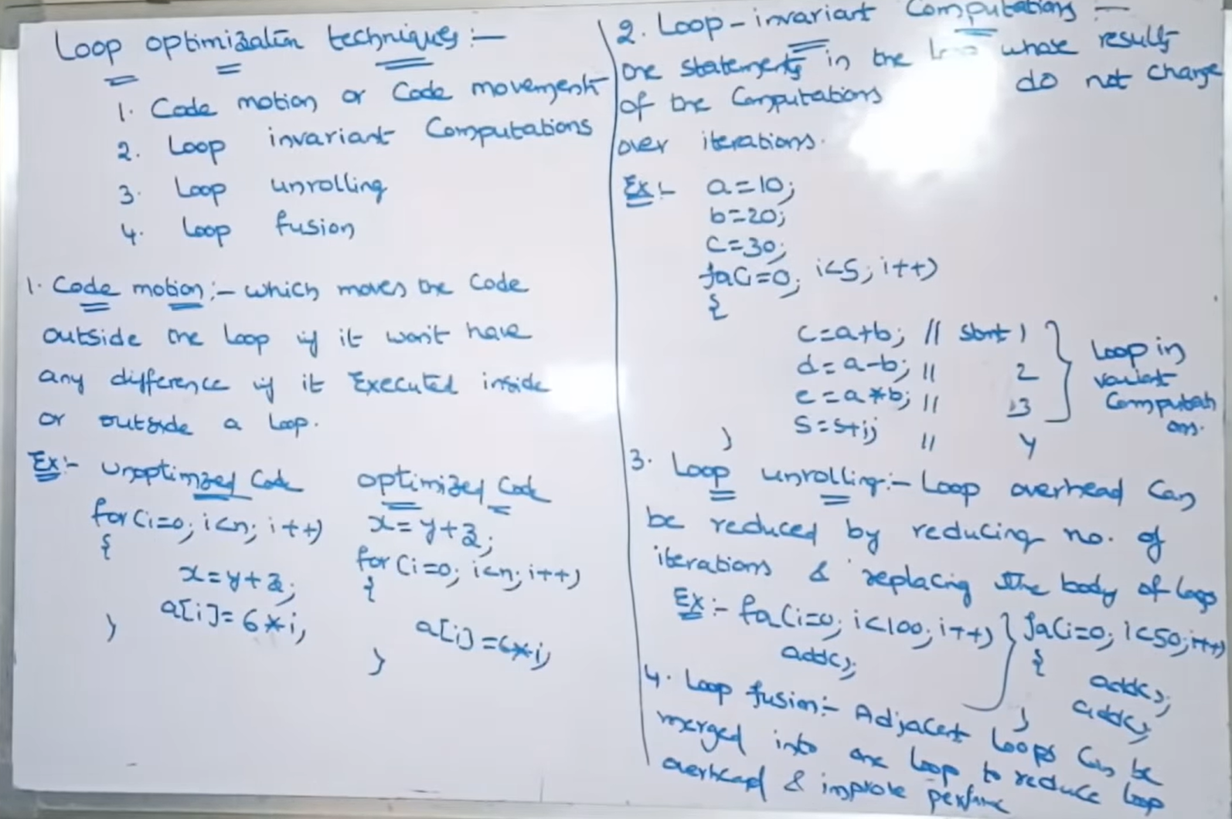
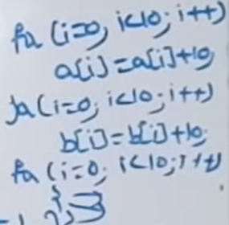

Slide 2
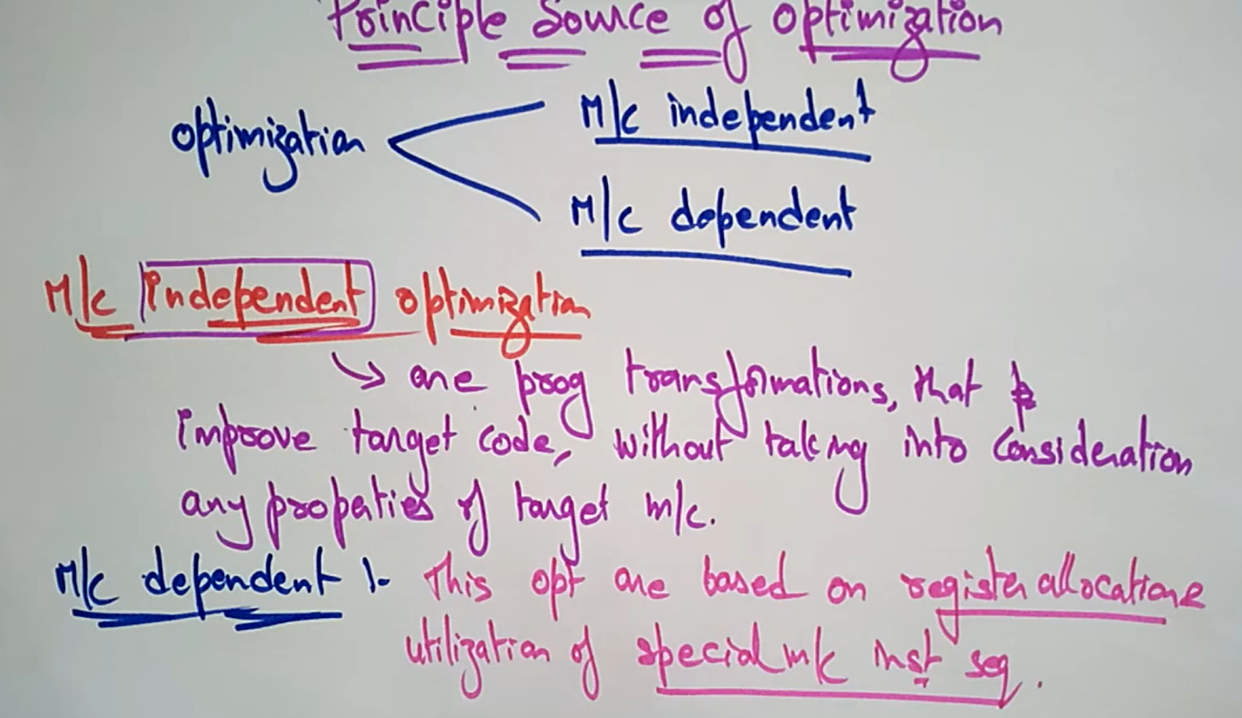

Slide 3
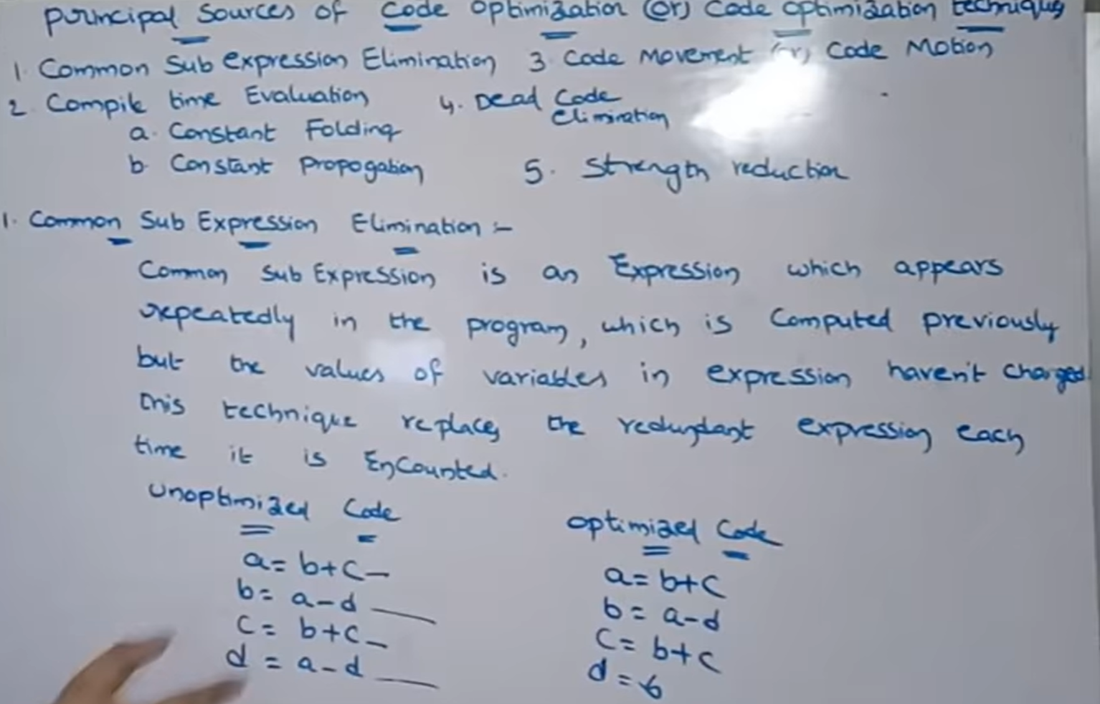

Slide 4
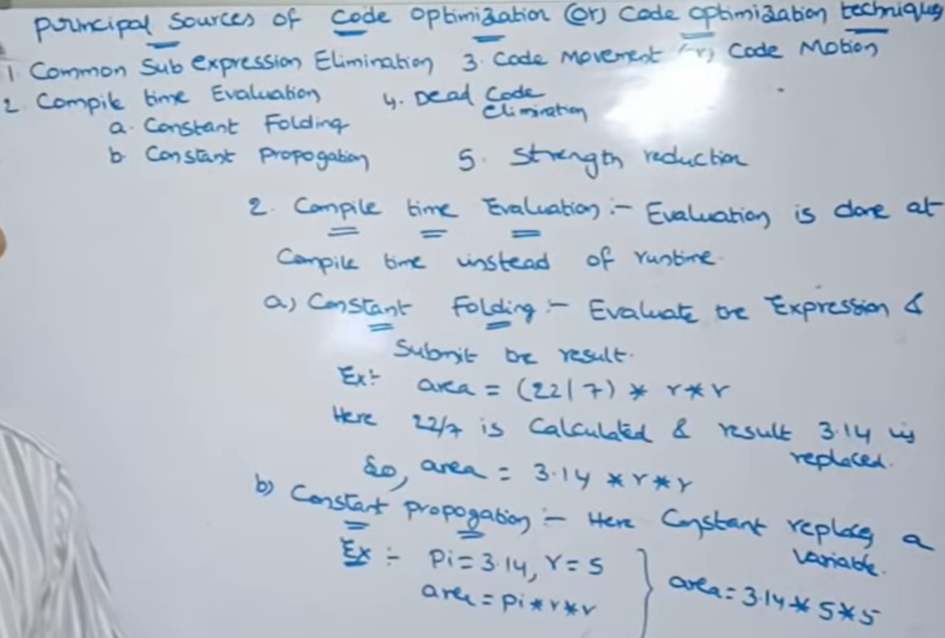

Slide 5
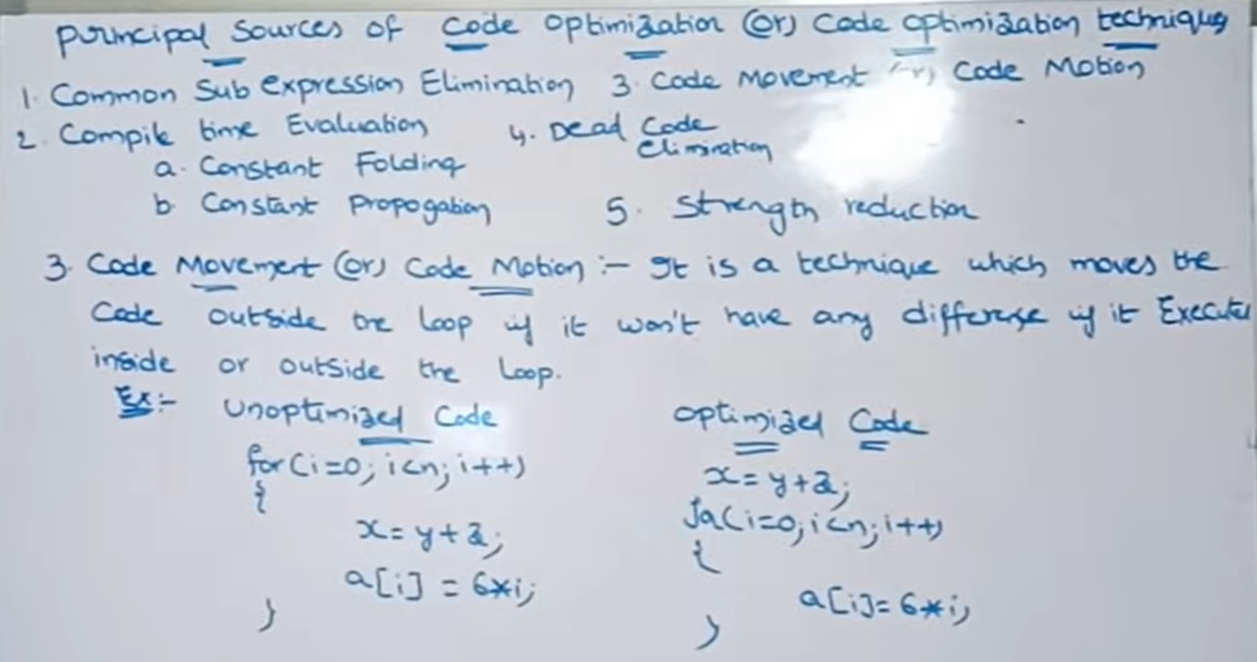

Slide 6
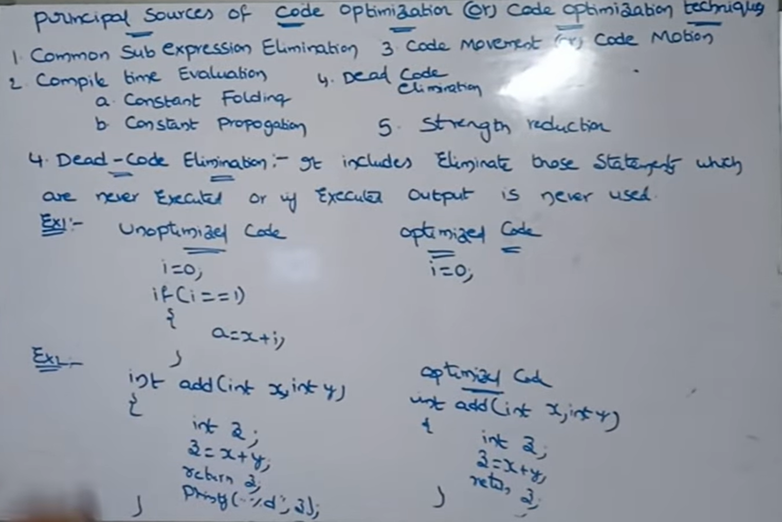

Slide 7
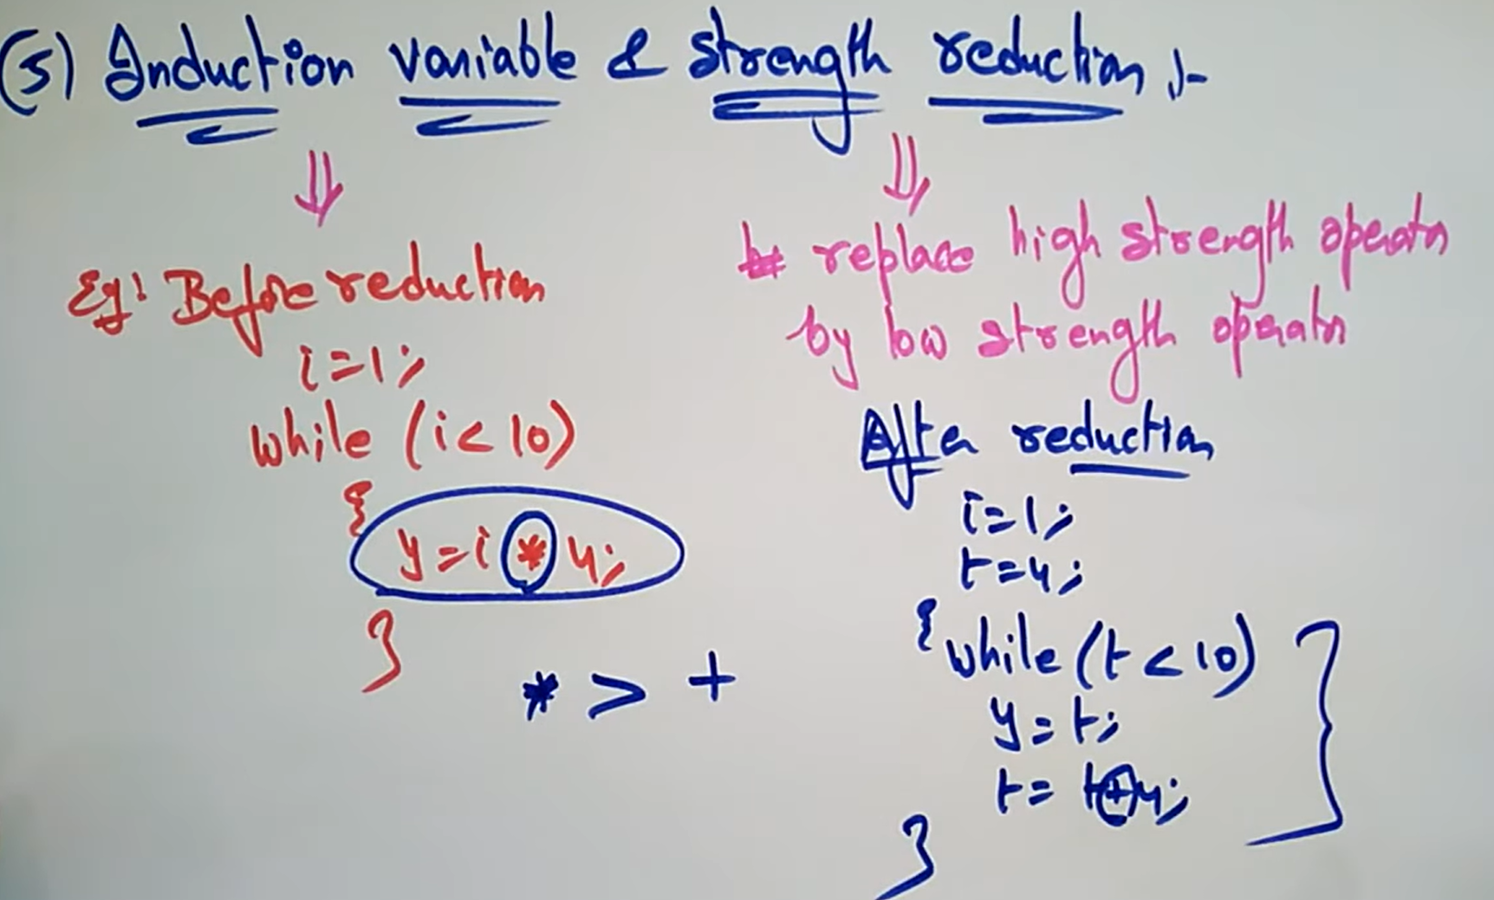

Slide 8
Basic blocks and flow graphs
A basic block is a collection of statements which are always executed in a sequential manner
Properties of basic blocks:
Partition the intermediate code into basic blocks
The flow of control can only enter the basic block through the first instruction in the block. That is, there are no jumps into the middle of the block.
Control will leave the block without halting or branching, except possibly at the last instruction in the block.
It should not contain conditional statements as well as unconditional statements in the middle of the block. It can be first or last statement of the block
The basic blocks become the nodes of a flow graph

Slide 9
Example: x = a+b+c
Convert it into three address code
t1 = a+b
t2 = t1+c
x = t2
This is the basic block

Slide 10
Algorithm for partitioning a 3AC into Basic Blocks Rule1: Determining (finding) the leaders
The first three-address instruction in the intermediate code is a leader.
Any instruction that is the target of a conditional or unconditional jump is a leader.
Any instruction that immediately follows a conditional or unconditional jump is a leader.
Rule2: Determining the Basic Blocks
Beginning at the leader statement and ends before the next leader

Slide 11







Flow graph is a directed graph in which the flow control information (directions from one node to another node) is added to Basic Blocks. Here nodes are BBs.
Flow graph is a collection of nodes where we can have edges from one BB to another BB. Here the edge BB1 to BB2 means BB2 follow BB1.
BB1 is the predecessor of BB2 and BB2 is the successor of BB1

Slide 12
Loops: A loop is a collection of nodes in a flow graph such that 1. All nodes in the collection are strongly connected 2. The collection of nodes has a unique entry Inner loops: A loop the contain no other loops is called inner loop

Slide 13
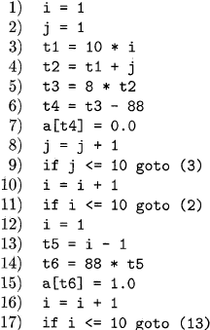
Intermediate code to set a 10*10 matrix to an identity matrix

Slide 14
Flow graph based on Basic Blocks

